Slide 1
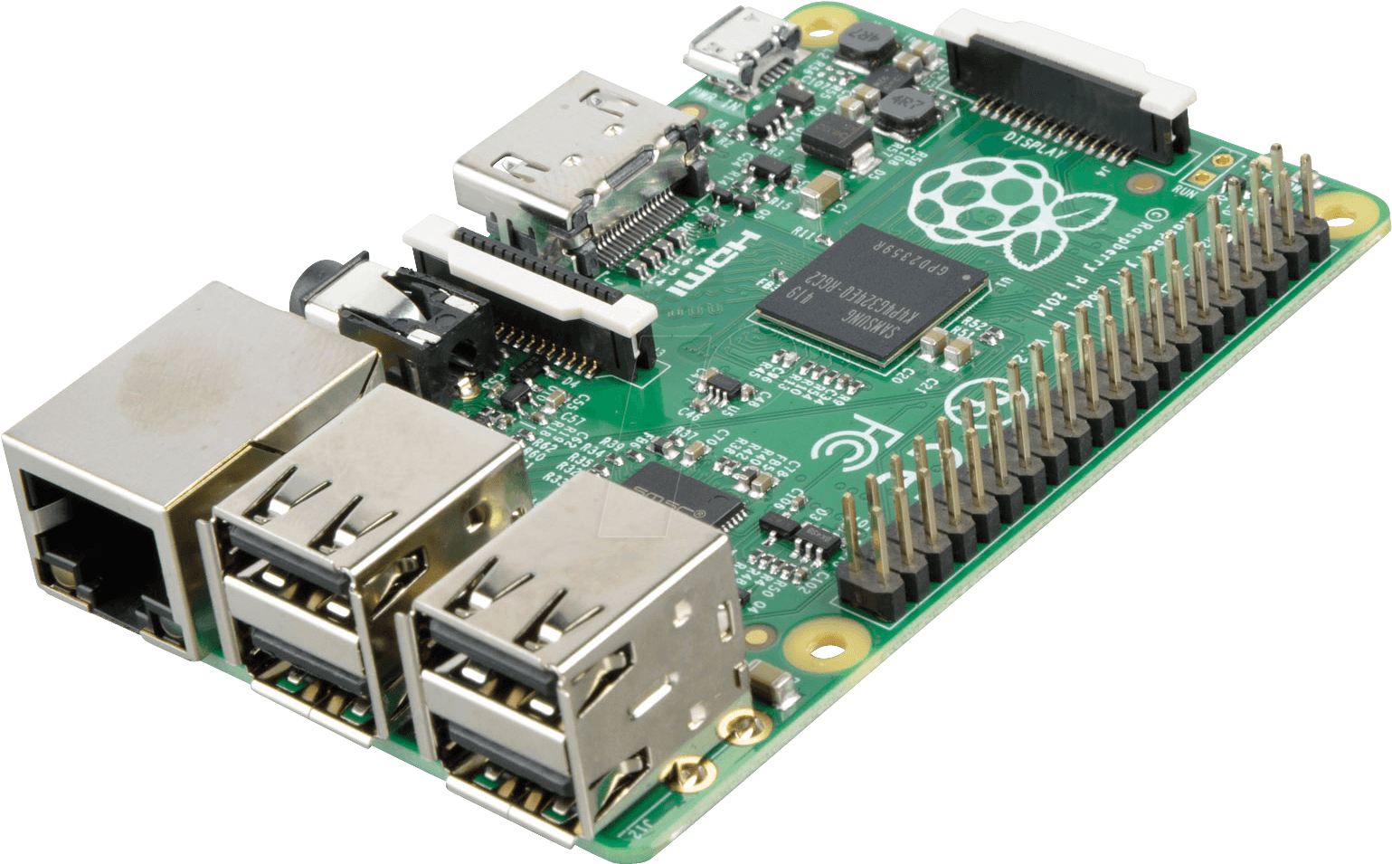
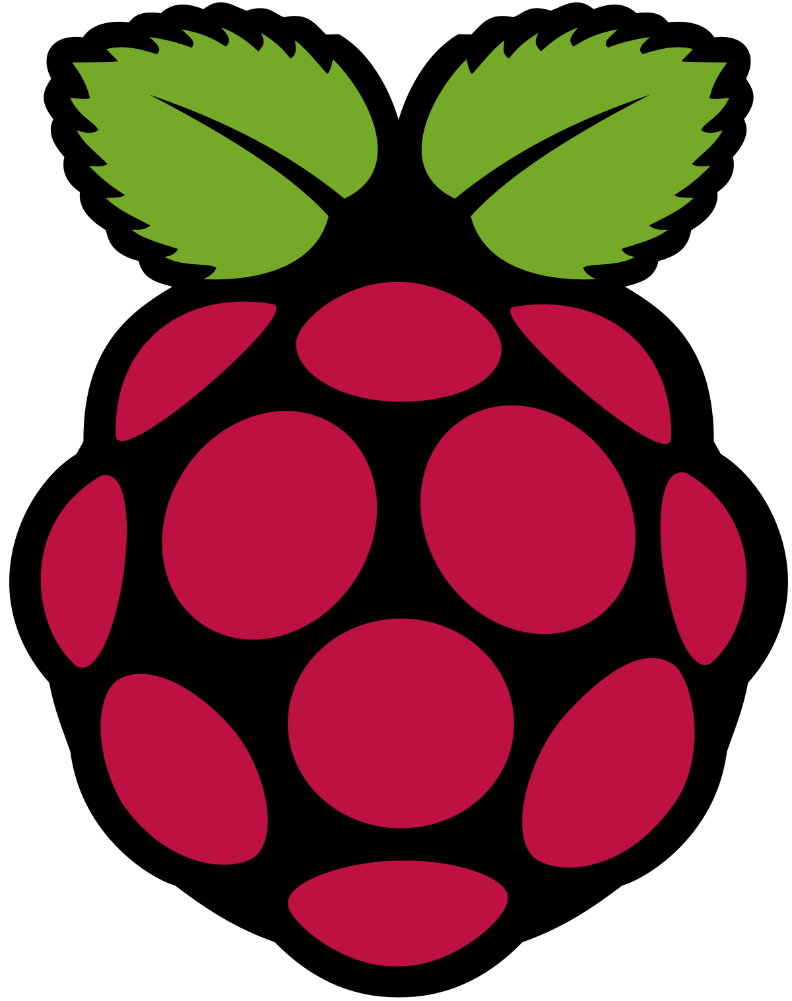
Pertemuan 6
Image Processing Part 2
Crop Image
Resize Image
Convert Color
Belajar
Image Processing di Raspberry Pi

Slide 2
Crop Image

Slide 3
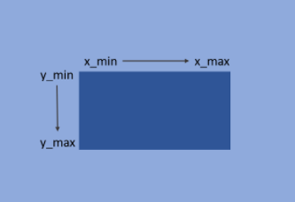
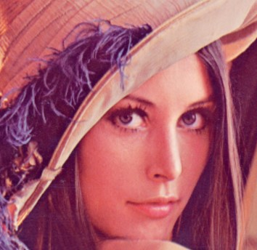
Crop Image
crop image pada OpenCV dilakukan dengan menggunakan numpy slicing
dengan notasi image_array[y_min:y_max , x_min:x_max]
dimana y_min, y_max, x_min dan x_max merupakan titik pixel batas area yang ingin di crop.
ilustrasi crop image
Original image
Coped Image

Slide 4
Crop Image
Import library (OpenCV, Matplotlib)
Display Image
import cv2
import matplotlib.pyplot as plt
import os
def show_image(img, title= 'my image', size=(10, 7)):
img_reverse = img[ :, :, ::-1]
plt.figure(figsize=size)
plt.imshow(img)
plt.title(title)
plt.axis('off')
show_image(img, title= 'croped image')
Read Image
img = cv2.imread('path/to/filename')
Crop Image
crop_img = img[0:100, 50:200, :]
image_array[y_min:y_max , x_min:x_max, :]

Slide 5
Crop Image Kode Keseluruhan
Kode keseluruhan
import cv2
import matplotlib.pyplot as plt
img = cv2.imread('path/to/filename')
crop_img = img[0:100, 50:200, :]
show_image(img , title= 'croped image')

Slide 6
Crop Image dalam Function
Crop image dalam function dengan cama crop, selanjutnya kita dapat gunakan fucntion tersebut untuk memabaca image dan crop gambar
def crop(img, y_min, y_max, x_min, x_max):
crop_img = img[0:100, 50:200, :]
return crop_img
img = cv2.imread('path/to/filename')
crop_img = crop(img, 0, 100, 50, 200)
show_image(crop_img, title= 'croped image')

Slide 7
Crop Multiple Image
Crop multiple image menggunakan library os
filenames = os.listdir("folder_1")
for name in filenames :
print(name)
img = cv2.imread("folder_1/" + name)
crop_img = crop(img, 0, 100, 50, 200)
show_image(crop_img, title= 'croped image : %s' % name)

Slide 8
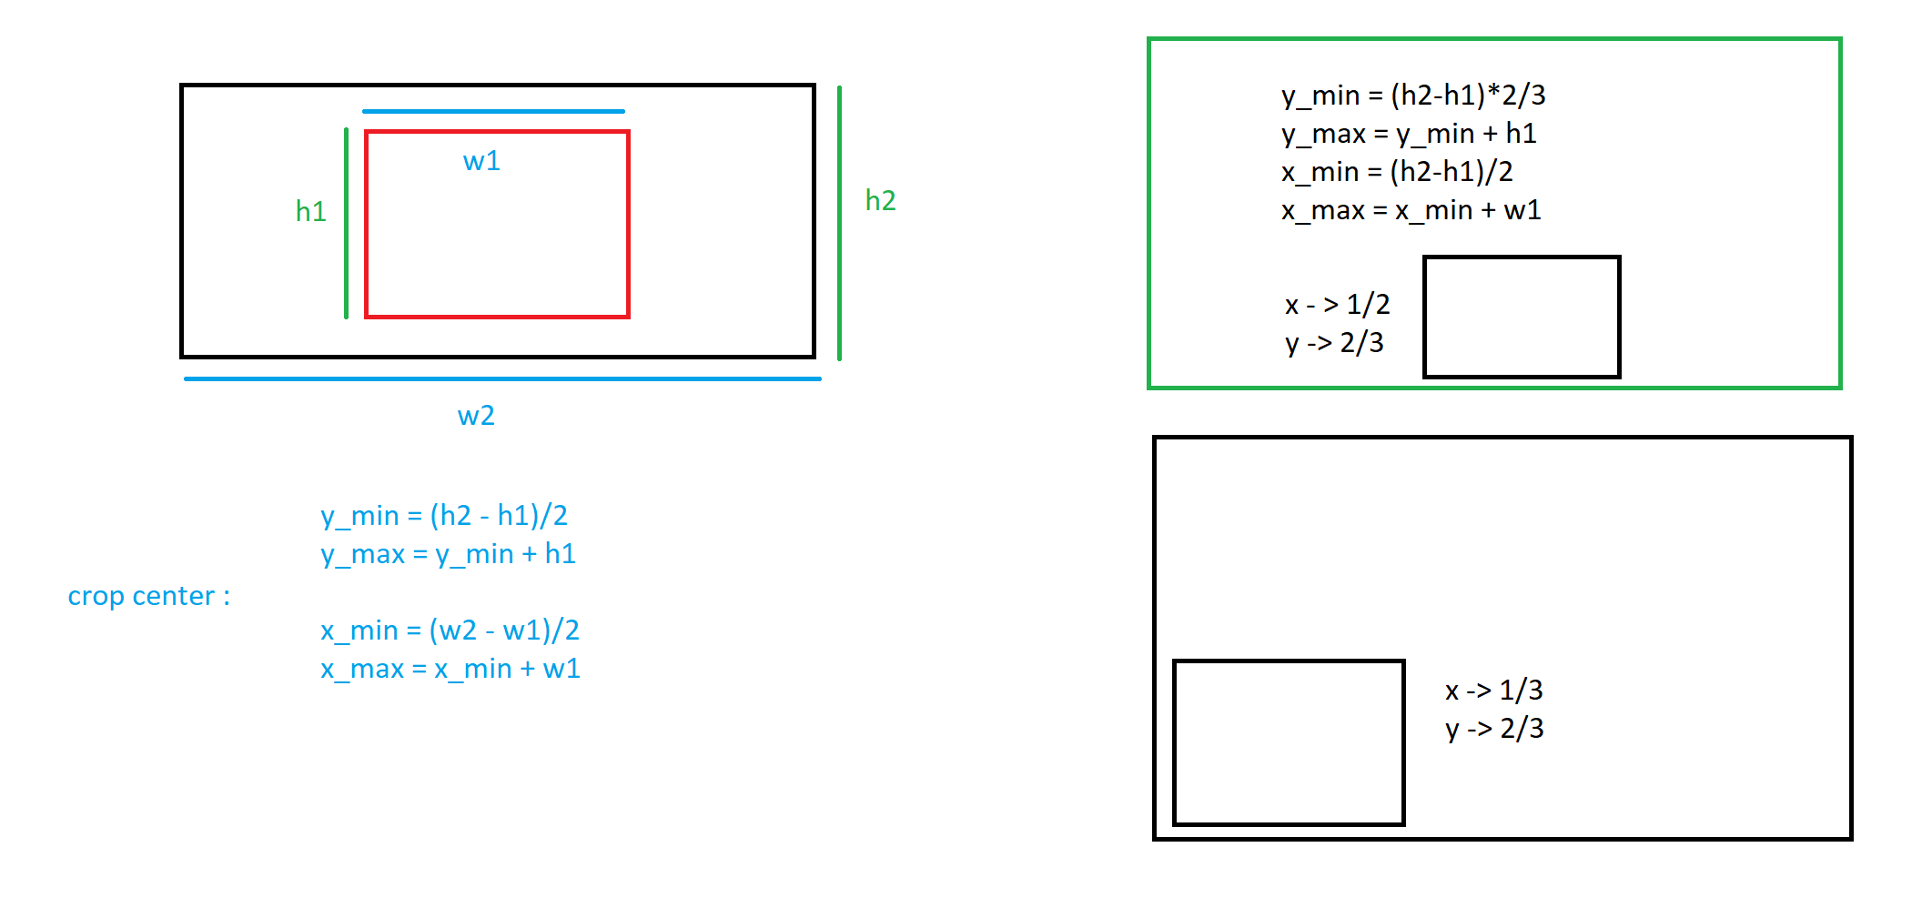
Crop dengan ukuran sama

Slide 9
Crop dengan ukuran sama
h_crop = 200
w_crop = 200
filenames = os.listdir("folder_1")
for name in filenames :
print(name)
img = cv2.imread("folder_1/" + name)
h, w, c = img.shape
y_min = int((h - h_crop)/2)
y_max = y_min + h_crop
x_min = int((w - w_crop)/2)
x_max = x_min + w_crop
print(y_min, y_max, x_min, x_max)
crop_img = crop(img, y_min, y_max, x_min, x_max) # crop 20% atas, bawah, kanan, kiri
h, w, c = crop_img.shape
resize_img = resize(crop_img, size=(w*2, h*2)) # rescale 2x lebar dan tinggi
show_image(resize_img, title= 'resized image : %s ' % name)

Slide 10
Resize Image

Slide 11
Resize Image
Read Image
img = cv2.imread('path/to/filename')
Original image
Resized image
resize Image
resize_img = cv2.resize(img, (320, 240))
untuk melakukan resize image pada OpenCV diprkenalkan beberapa method berikut :
cv2.resize(img, (w_new, h_new)) : resize img ke ukuran w_new x h_new
Display Image
show_image(resize_img, title= 'resized image')

Slide 12
Resize Image Kode Keseluruhan
Read Image
img = cv2.imread('path/to/filename')
resize_img = cv2.resize(img, (320, 240))
show_image(resize_img, title= 'resized image')

Slide 13
Resize Image dalam Function
Function resize
def resize(img, size=(320,240)):
resize_img = cv2.resize(img, size)
return resize_img
img = cv2.imread('path/to/filename')
resize_img = resize(img, size=(720, 680))
show_image(resize_img, title= 'resized image')

Slide 14
Resize Multiple Image
resize multiple image menggunakan library os
filenames = os.listdir("folder_1")
for name in filenames :
print(name)
img = cv2.imread(name)
resize_img = resize(img, size=(720,680))
show_image(resize_img, title= 'resized image')

Slide 15
Resize & Crop Multiple Image
resize multiple image menggunakan library os
filenames = os.listdir("folder_1")
for name in filenames :
print(name)
img = cv2.imread("folder_1/" + name)
crop_img = crop(img, 20, 100, 50, 150)
resize_img = resize(crop_img, size=(720, 680))
show_image(resize_img, title= 'resized image : %s ' % name)

Slide 16
Convert Image Color

Slide 17
Image Color Conversion
Diperkenalkan method cv2.cvtColor(img, method) untuk color conversion pada OpenCV
Berikut adalah method convert color yang dapat digunakan :
convert BGR <--> RGB
cv2.COLOR_BGR2RGB
cv2.COLOR_RGB2BGR
convert BGR <--> HSV
cv2.COLOR_BGR2HSV
cv2.COLOR_HSV2RGB
convert BGR <--> GRAY
cv2.COLOR_BGR2GRAY
cv2.COLOR_GRAY2RGB
Original image
Grayscale image

Slide 18
Convert To Grayscale
Read Image
Display Image
img = cv2.imread('path/to/filename')
def show_image_gray(gray, title= 'my image', size=(10, 7)):
plt.figure(figsize=size)
plt.imshow(gray, cmap='gray')
plt.title(title)
plt.axis('off')
plt.show()
show_image_gray(gray_img , title= 'grayscale image')
Convert image to grayscale
gray_img = cv2.cvtColor(img, cv2.COLOR_BGR2GRAY)
melakukan convert image dari BGR to GRAY
cv2.cvtColor(img, method)

Slide 19
Convert To Grayscale Kode Keseluruhan
Convert image to grayscale
img = cv2.imread('path/to/filename')
gray_img = cv2.cvtColor(img, cv2.COLOR_BGR2GRAY)
show_image_gay(gray_img, title= 'gray image')

Slide 20
Convert To Grayscale didalam Function
Function Convert image to grayscale
def convert_gray(img):
gray_img = cv2.cvtColor(img, cv2.COLOR_BGR2GRAY)
return gray_img
img = cv2.imread('path/to/filename')
gray_img = convert_gray(img)
show_image(gray_img, title= 'gray image')

Slide 21
Convert Multiple Image To Grayscale
Covert multiple image to grayscale menggunakan library os
filenames = os.listdir("folder_1")
for name in filenames :
print(name)
img = cv2.imread(name)
gray_img = convert_gray(img)
show_image(gray_img, title= 'gray image : %s' % name)

Slide 22
Sumber
https://github.com/Muhammad-Yunus/Belajar-Computer-Vision/blob/master/08.%20OpenCV%20-%20Part%202/08.%20OpenCV%20-%20Part%202.ipynb

